Slide 1








By Hakeem inc

Slide 2


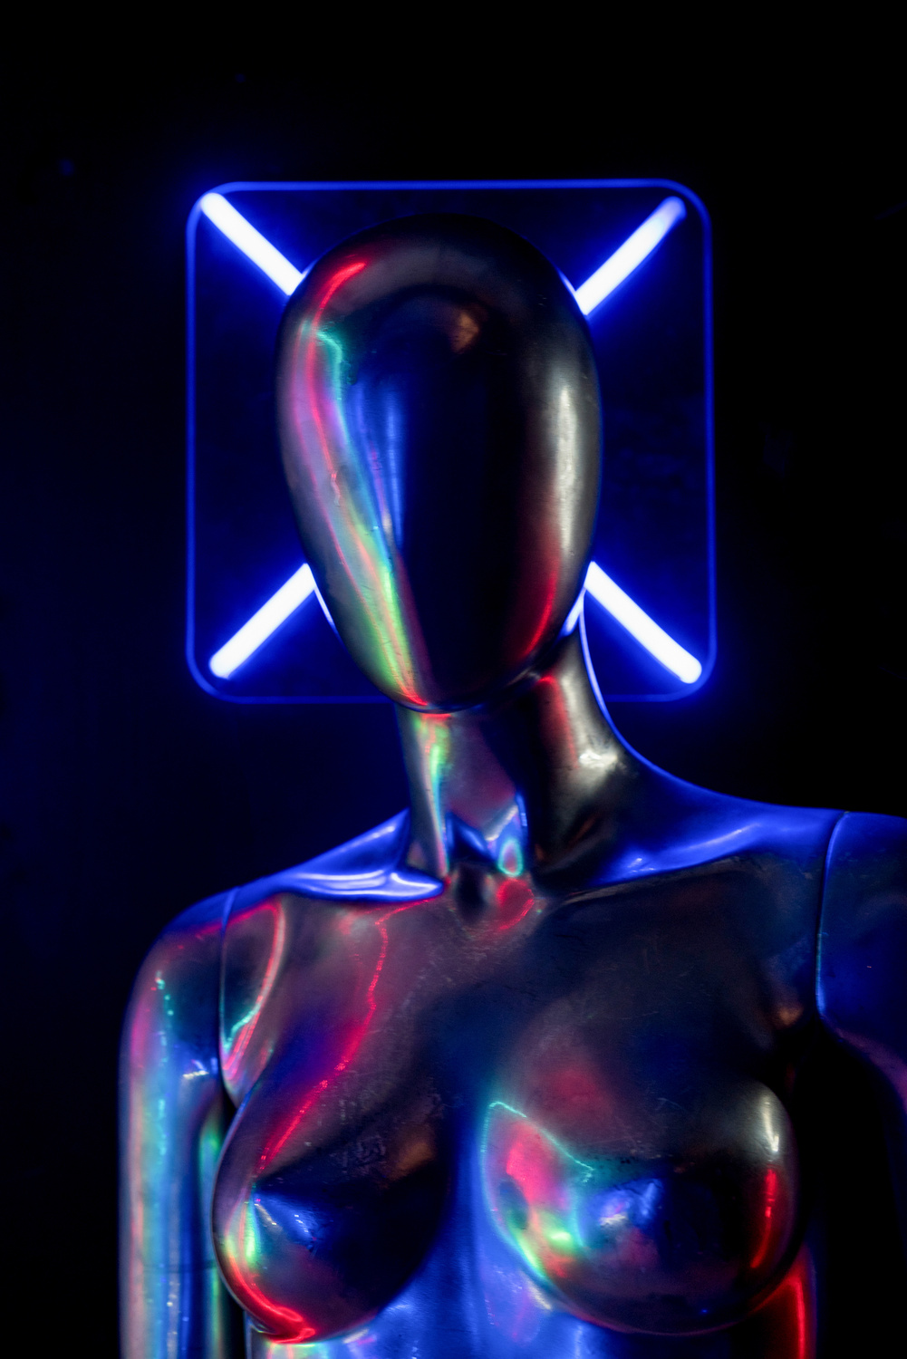


Team
Abdullah & Anass
Yusuf Aras
Nikita
Project manager
User Interface
User experience

Slide 3
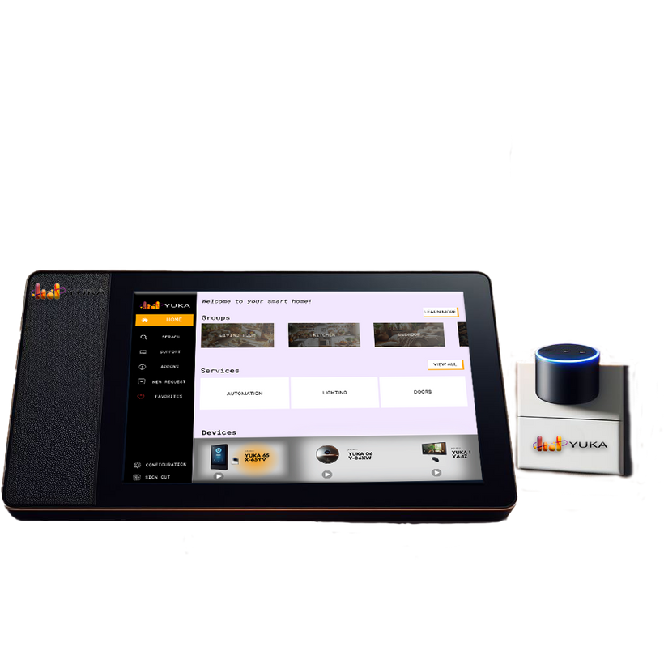
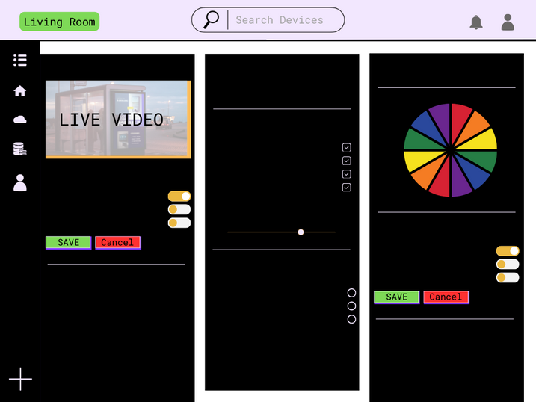
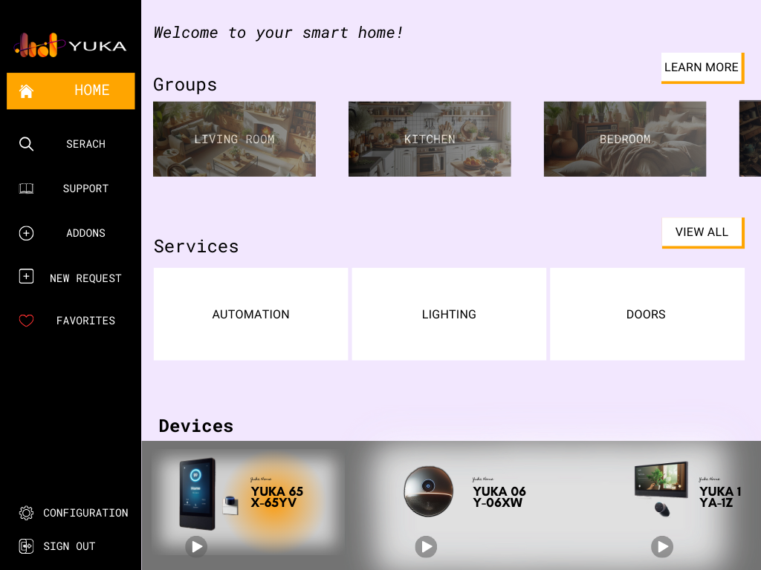


Roadmap

Slide 4



Bad sound quality as well as mishearing
No 3rd party support
Provide 0 real benefit
The Biggest problems with the current options

Slide 5

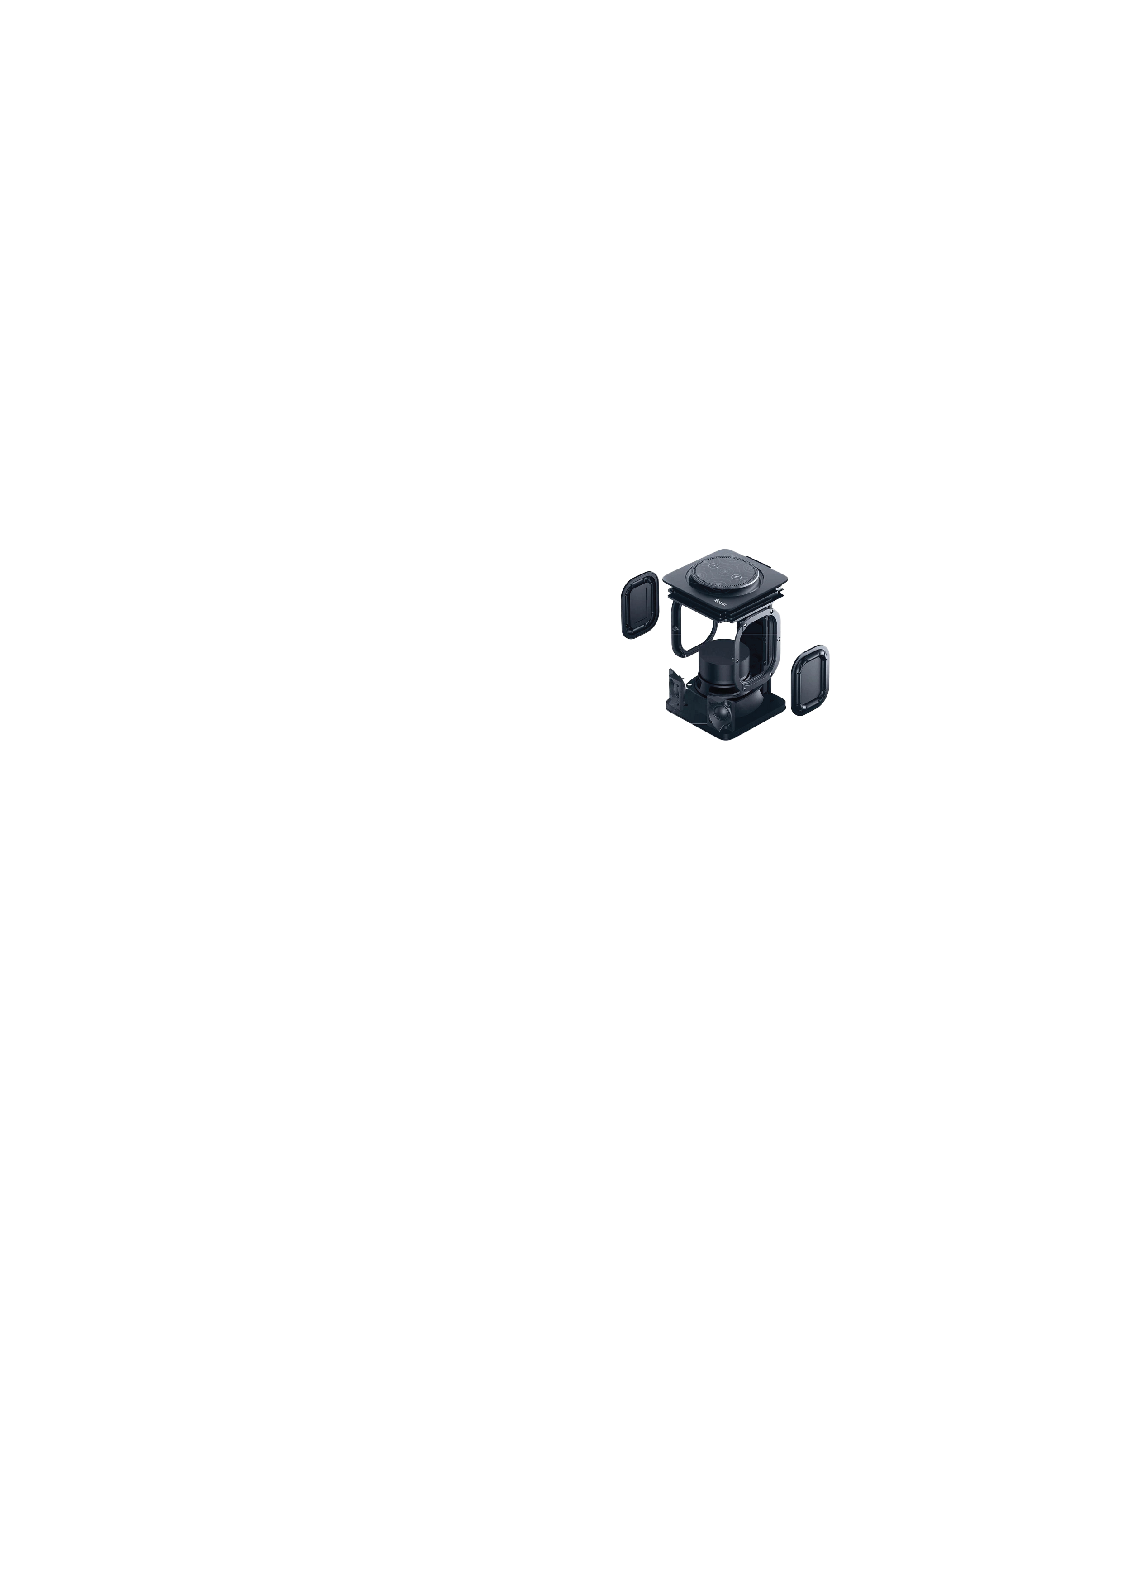
The perfect Device:
Built to fit any aesthetic
A 65w speaker by Bang & Olufsen
Microphone by Shure
Human like responses, using Chat-GPT
Control of the whole house using supported devices
Real time updates
LCD display
Music identification using SHAZAM
3rd party app support

Slide 6
Endless Possibilites
We have worked to provide seemless connectivity between a plethora of smart devices like Ring or Amazon products
These can all be catagorized and customized through the App
Yuka
Thermostat
CCTV Security
Smart TV
Lights
Speakers
Shopping List

Slide 7
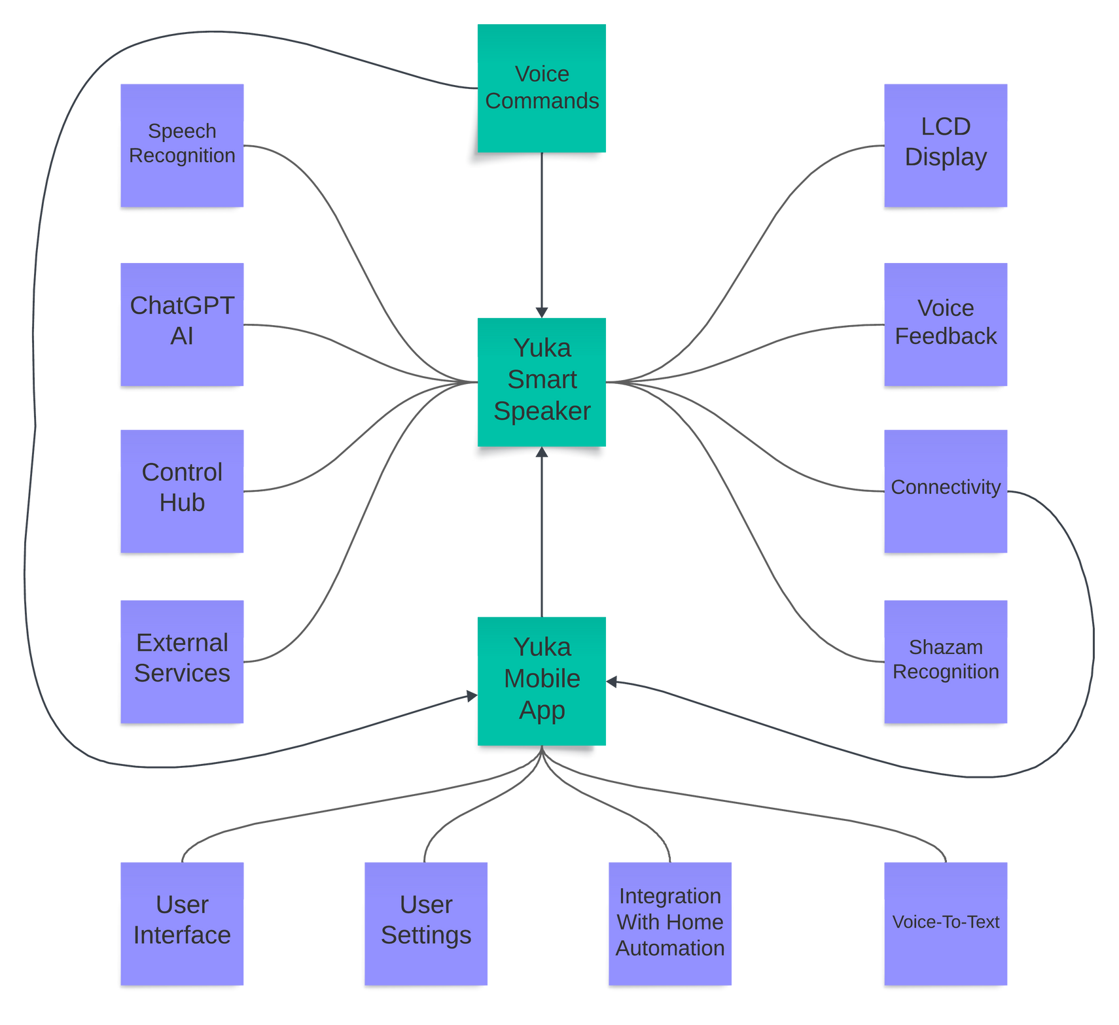



Slide 8
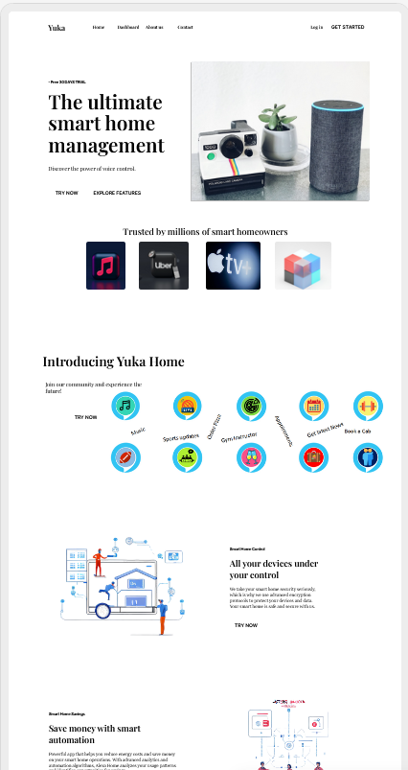
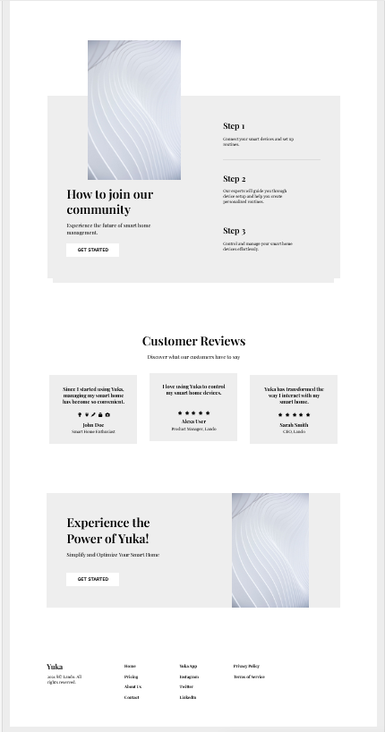

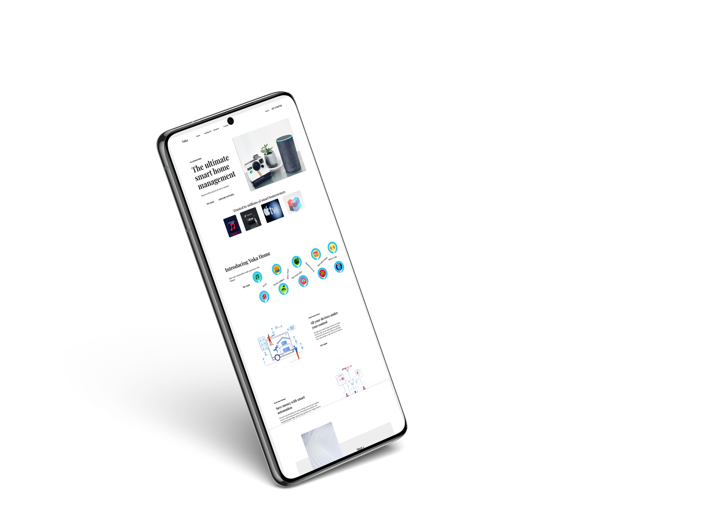
Home Page:

Slide 9
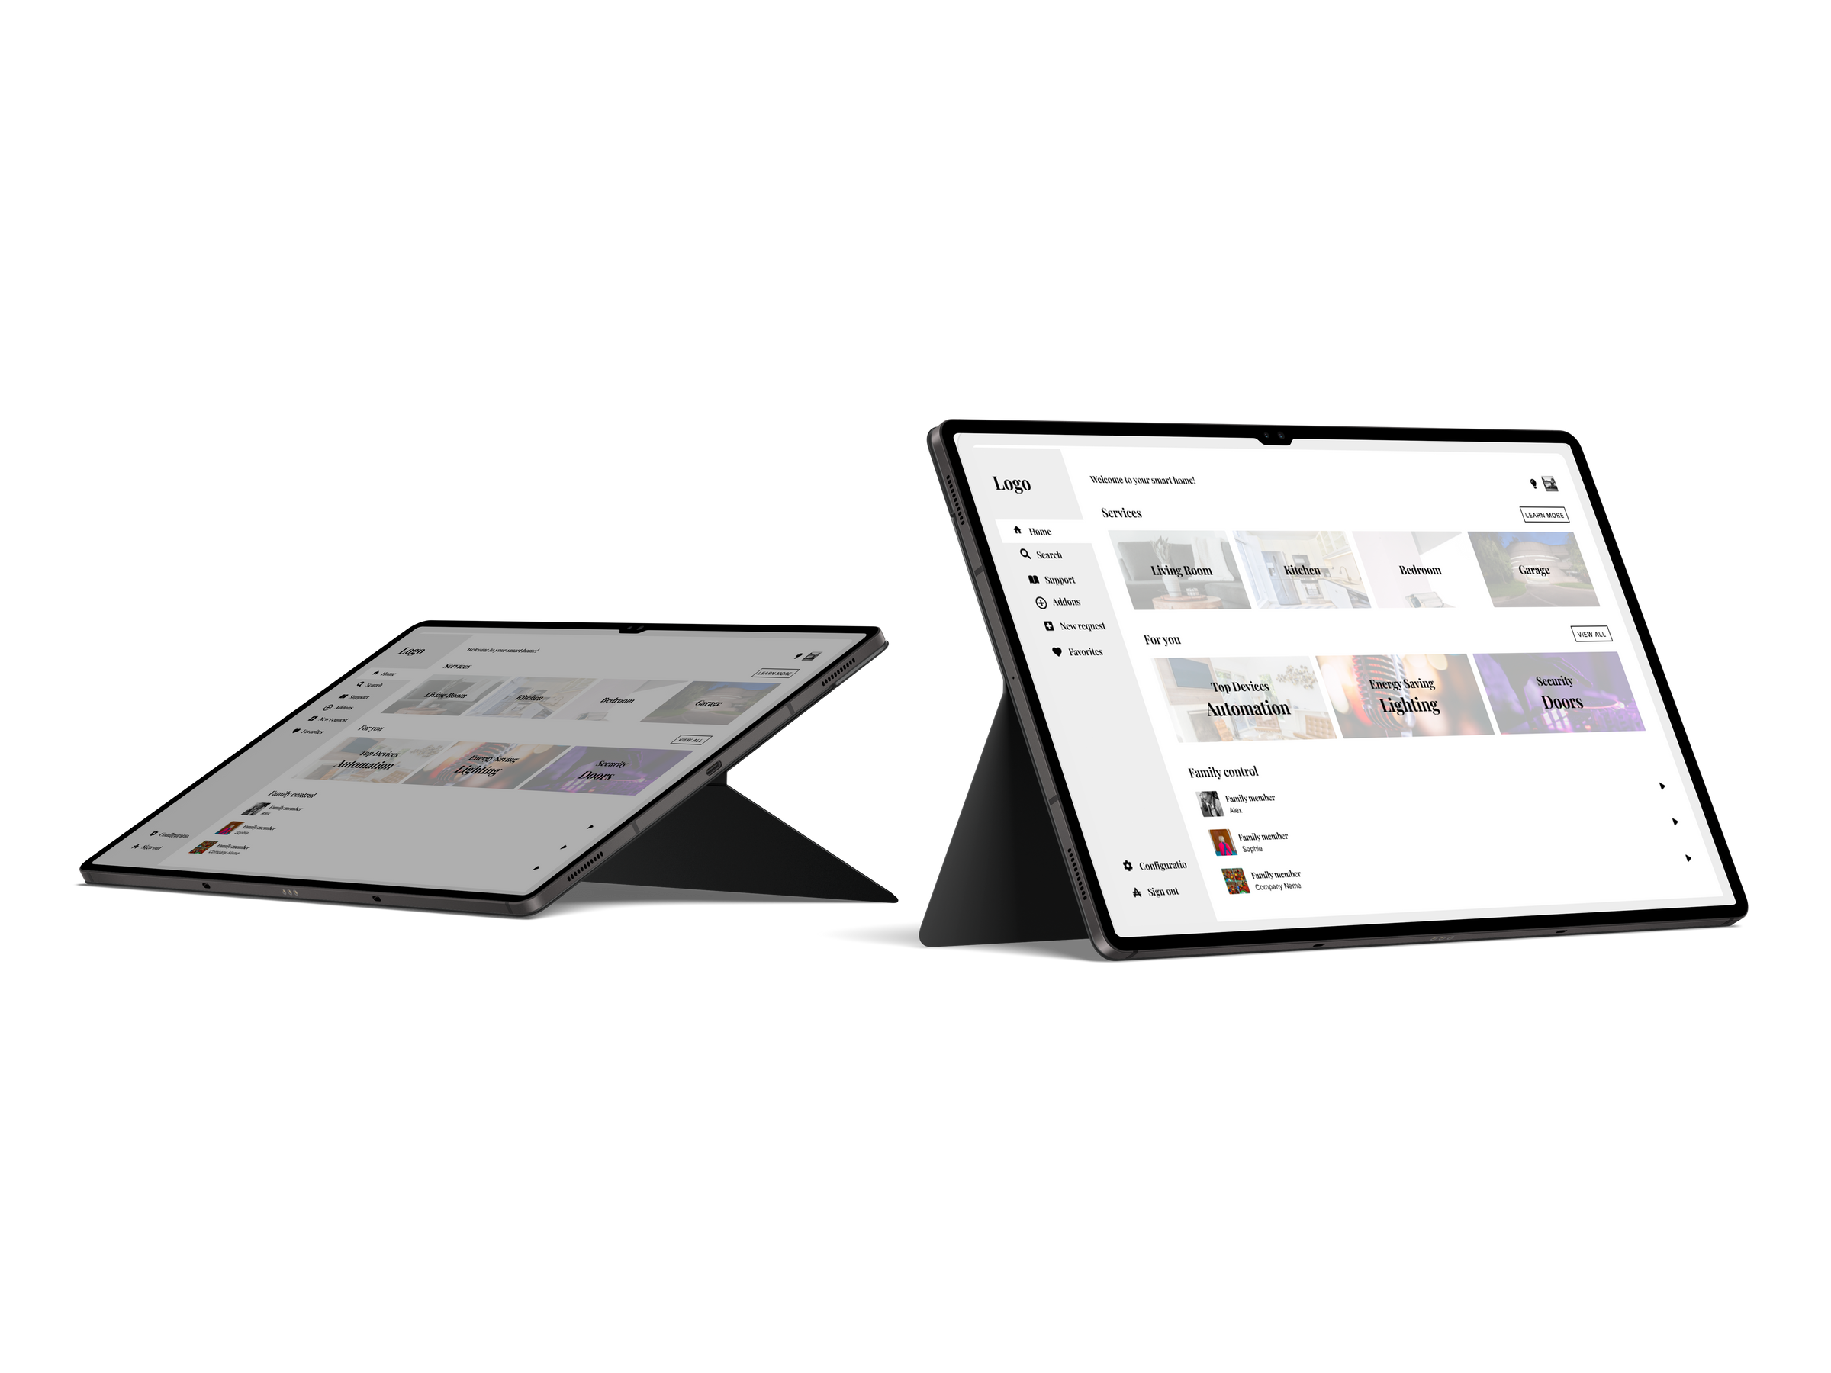
Dashboard:

Slide 10
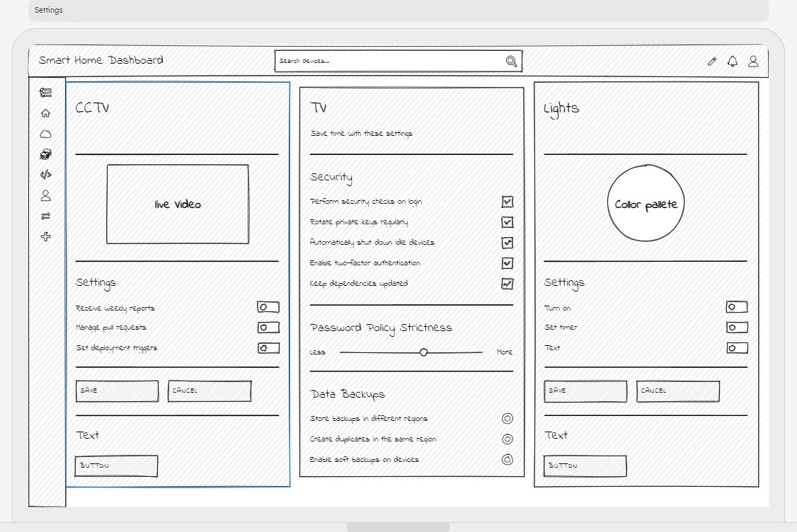
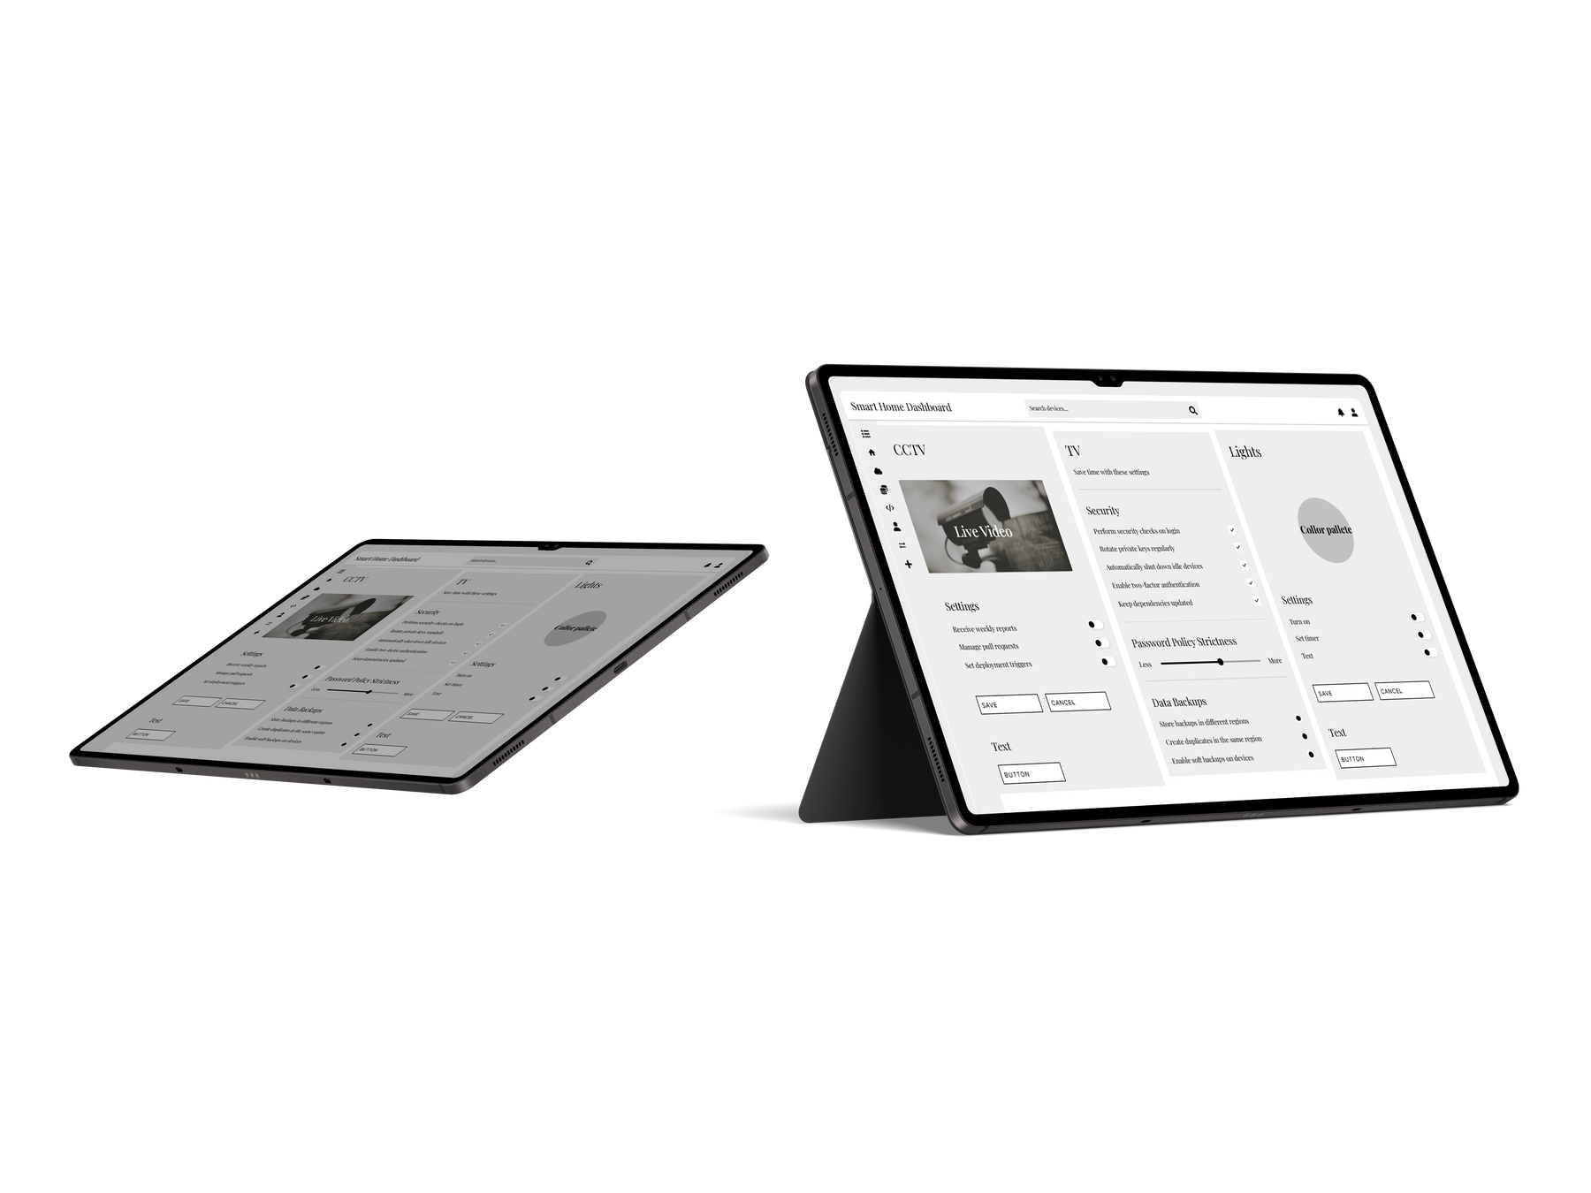
Product Page:

Slide 11
Wireframe
The design of the website is responsive and accessible
The website/app acts as a hub for yuka, allowing you to interact with Yuka, connect 3rd party appliences and plugins

Slide 12
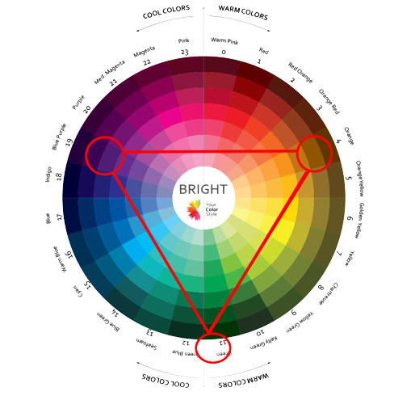
Colour scheme
The darker colours/shades are extracted from cyberpunk themes. They reflect the Ai and technical aspect of Yuka
The brighter colours are representive of nature and reflects Yukas intergration in your day to day life

Slide 13

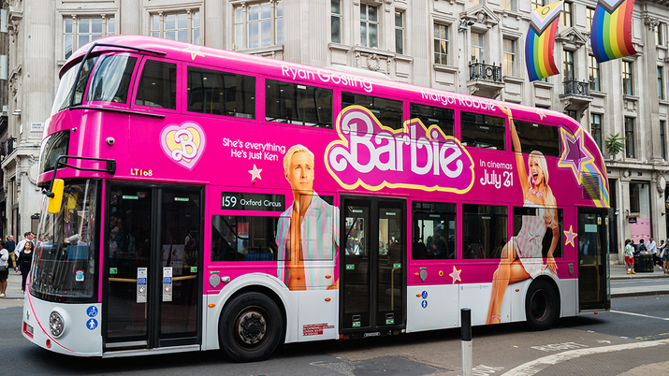
User Journey
The way the customers will get to know about our product is through various promotions such as: TV adverts, , billboards and bus adverts. This will raise awareness to potential buyers. Since the products has many features not found in other similar products, Yuka will be the most best product out of the others, which will push the buyer to visit our website and explore more, which will eventually lead them to
buying it.

Slide 14
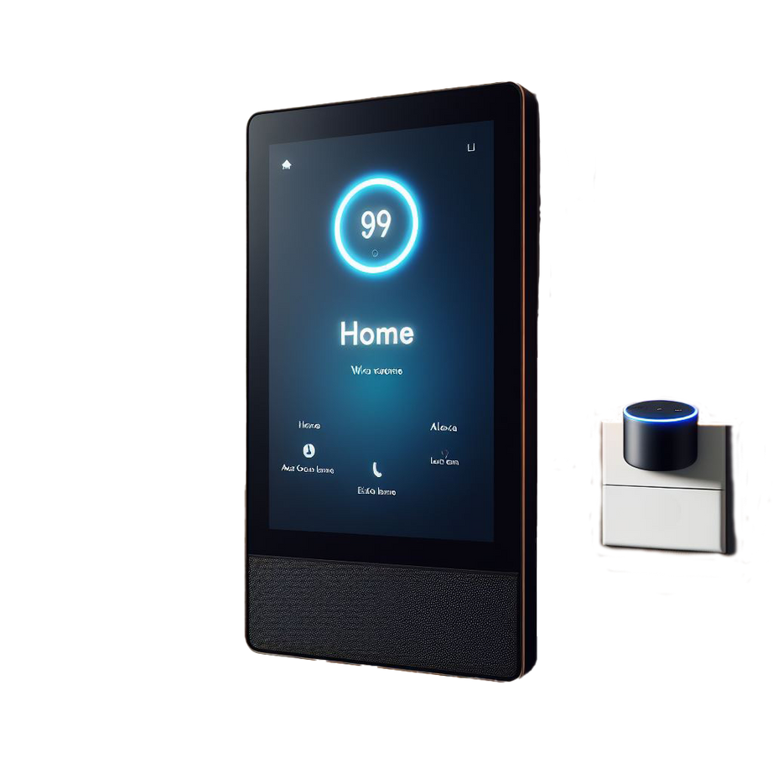
Yuka 65
X-65YV
High resolution, with oled on the screen.
YUKA integrates with voice assistant pod
We recommend y-06xw.

Slide 15
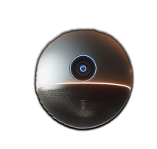
Yuka 06
y-06xw
3rd party application integration
Powerful audio and visual sensors.
Portable and pocket-friendly (an accessible luxury.)

Slide 16
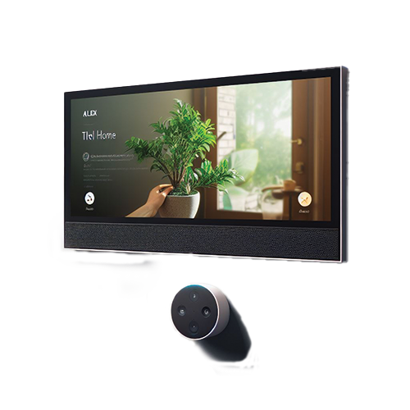
Yuka 1
YA-1z
Postative room control system.
High communication with cloud systems.
THE FLAGSHIP OF THE UPSTAIRS.

Slide 17
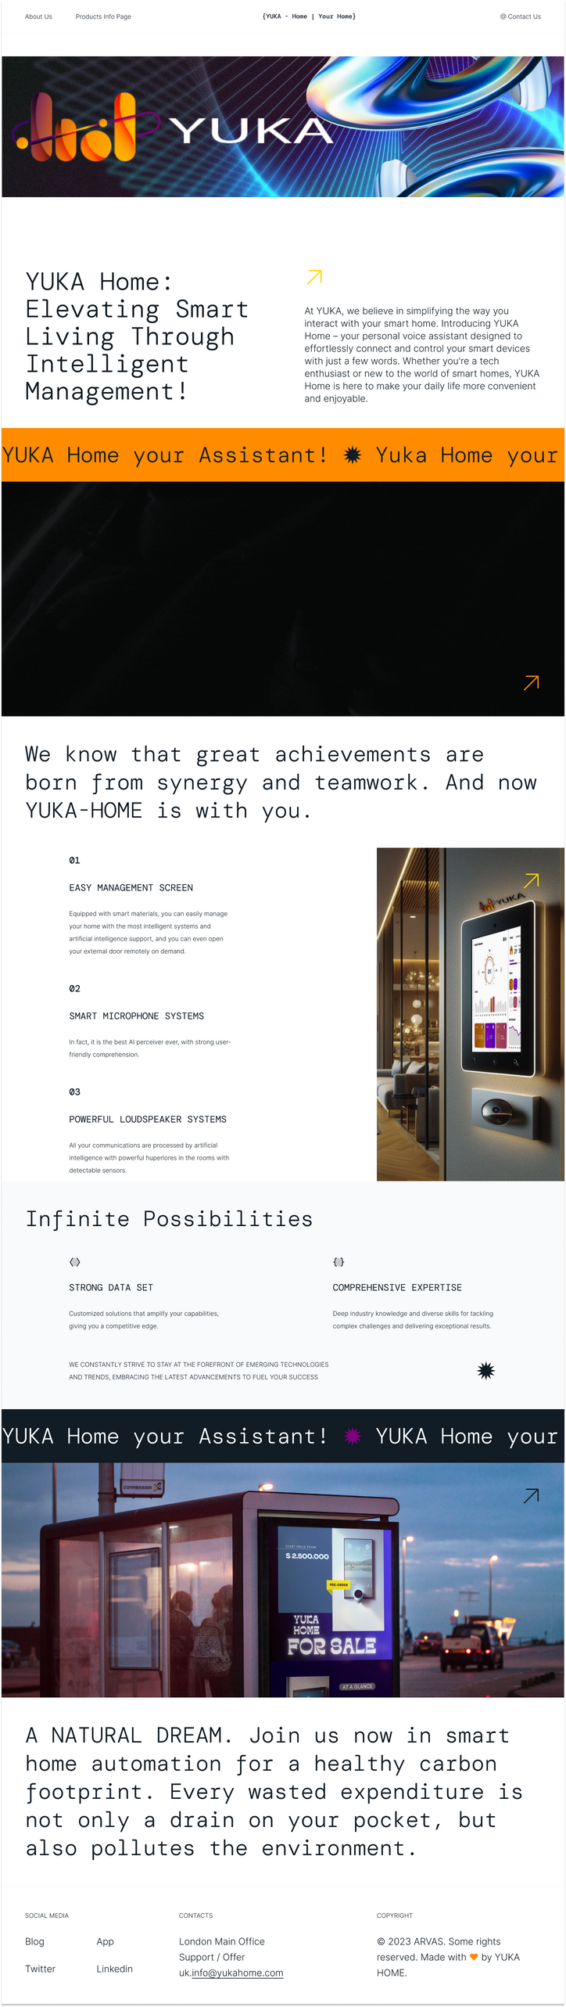
Yuka web {HOME}
The webpage reflects our marketing strategy and general target audience.

Slide 18
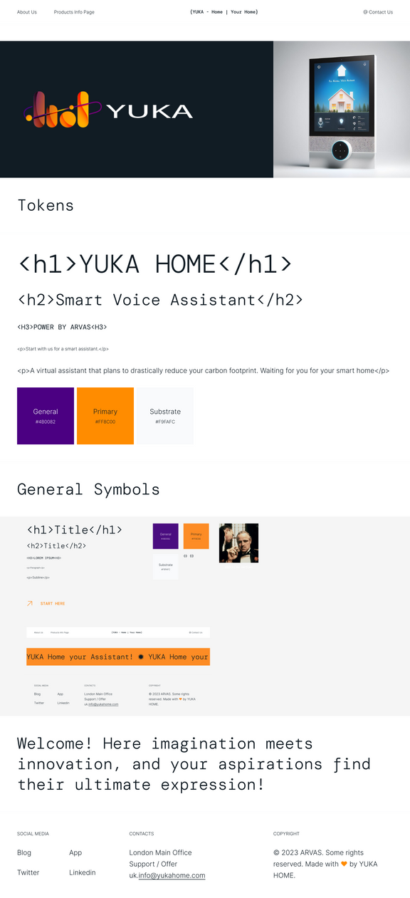
Yuka web {HOME}

Slide 19
